Slide 1

ROBOGARDEN BOOTCAMP

Slide 2
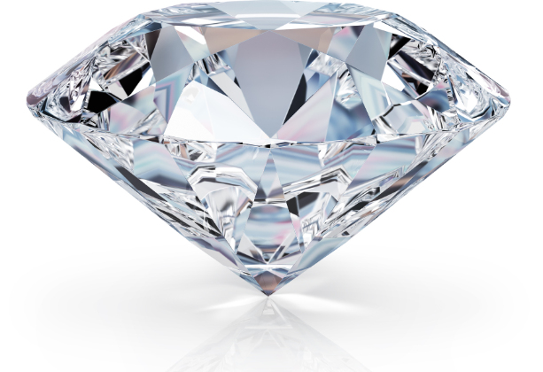
Capstone project on diamond dataset using classification, regression and clustering models
Presented by:
LINDA UKPELE
Machine Learning & AI Bootcamp

Slide 3
Introduction
Project Aim
Use machine learning to support data-driven marketing in the diamond business by predicting customer interest, optimizing pricing, and identifying key product features.
Problem Statement
New diamond businesses struggle with pricing, value assessment, and targeting the right customers. This project applies ML models (Classification, Regression and Clustering) to analyze product quality, predict price points, and identify potential buyers for smarter marketing decisions.
Who will benefit
Business Owners – Make informed decisions on pricing and customer targeting.
Marketing Teams – Run more precise and effective campaigns.
Investors – Gain confidence through data-backed insights.
ML Practitioners – Apply models to a real-world business challenge.

Slide 4
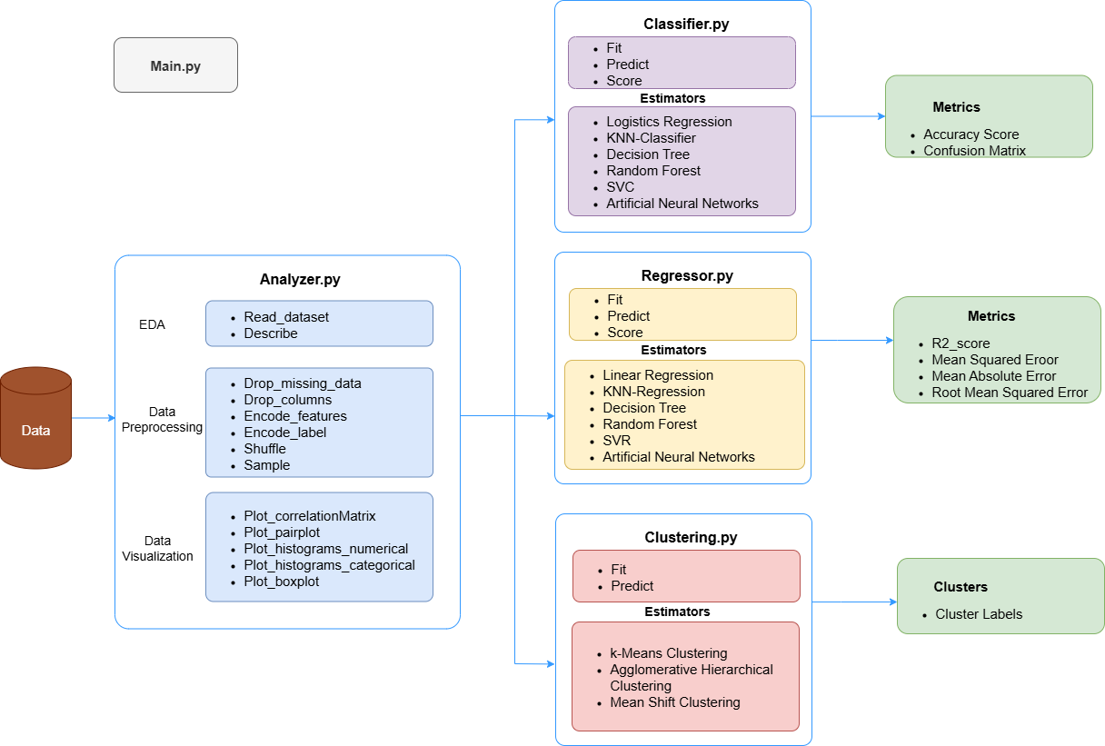
Flow Design

Slide 5
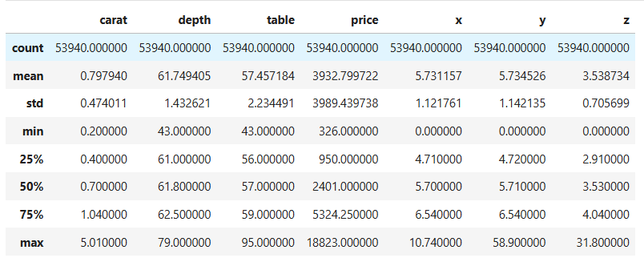
DESCRIPTION OF Data

Slide 6
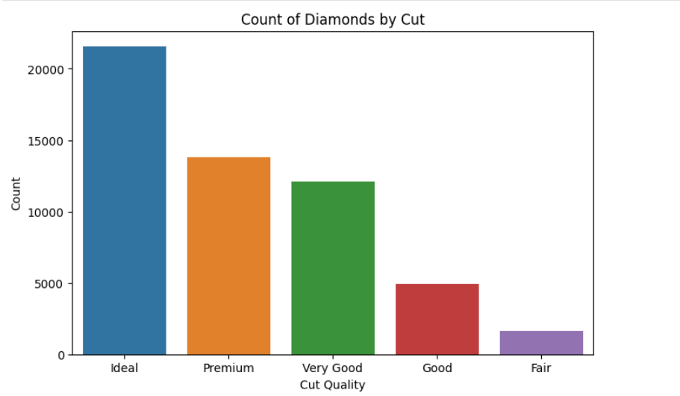
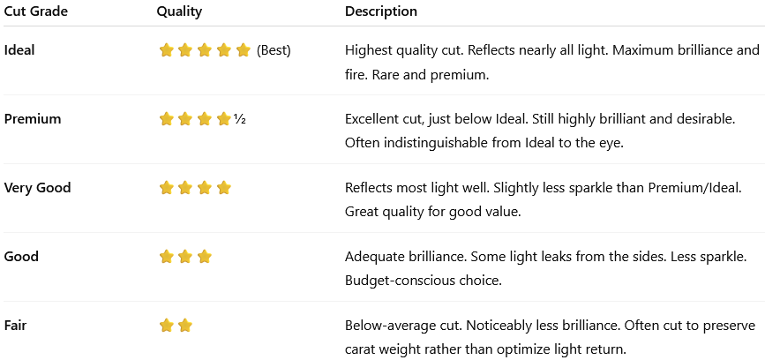
Histogram of diamonds by cut, clarity & color

Slide 7
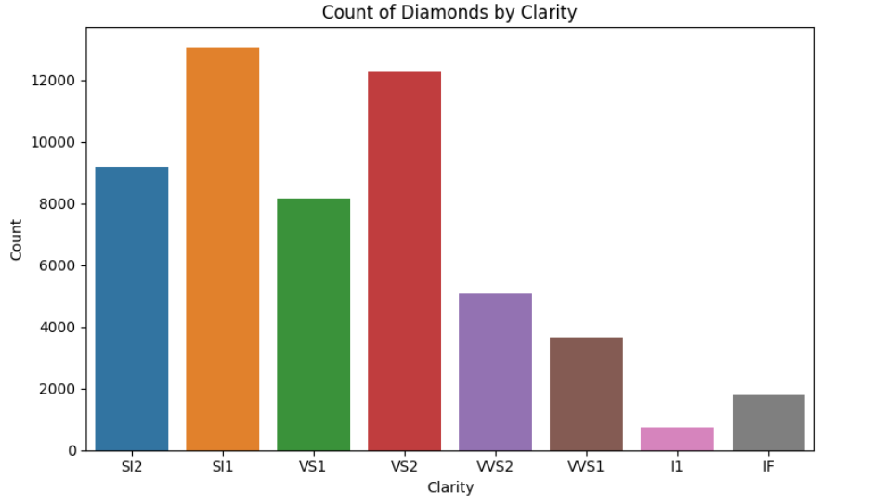
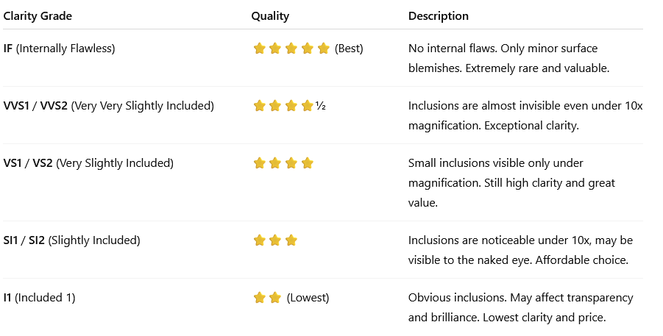
Diamonds by clarity

Slide 8
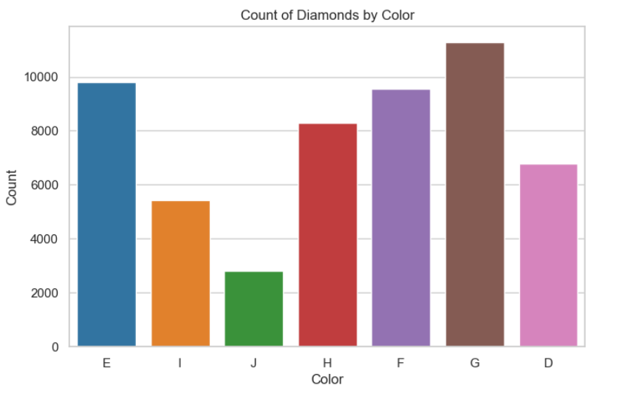
DIAMONDS BY COLOR
Summary (Best to Least):
D > E > F → Colorless G > H → Near Colorless I > J → Faint Color

Slide 9
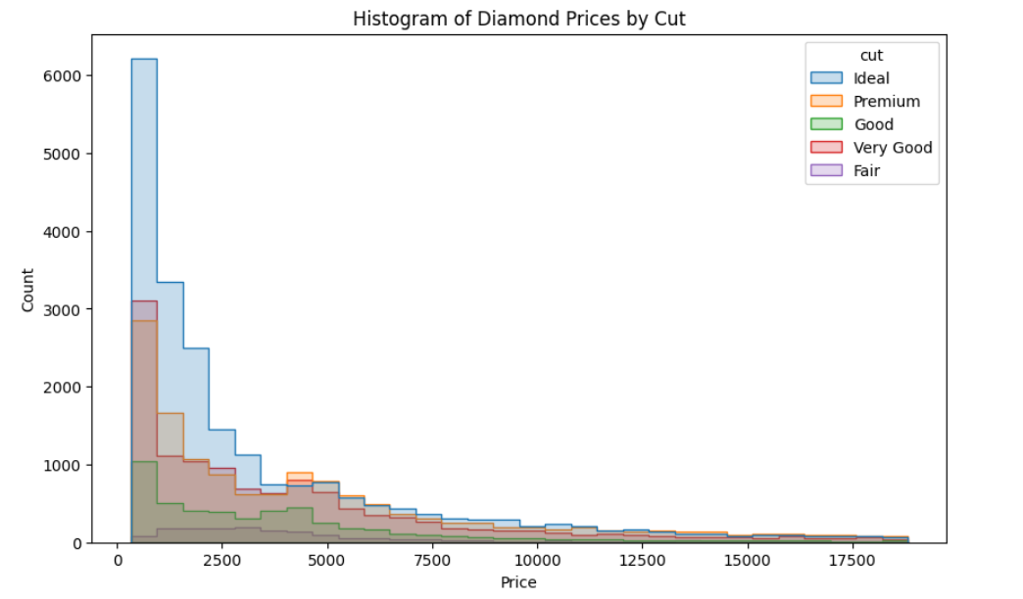
Histogram of diamond prices by cut
Despite quality differences, all cuts have similar shape:
High frequency at low prices.
Tapering off as price increases.
Business/Insight Takeaways
Most diamond sales happen in the affordable price segment, even for high-quality cuts.
Ideal and Premium cuts dominate the market — likely due to higher demand and better brilliance.

Slide 10
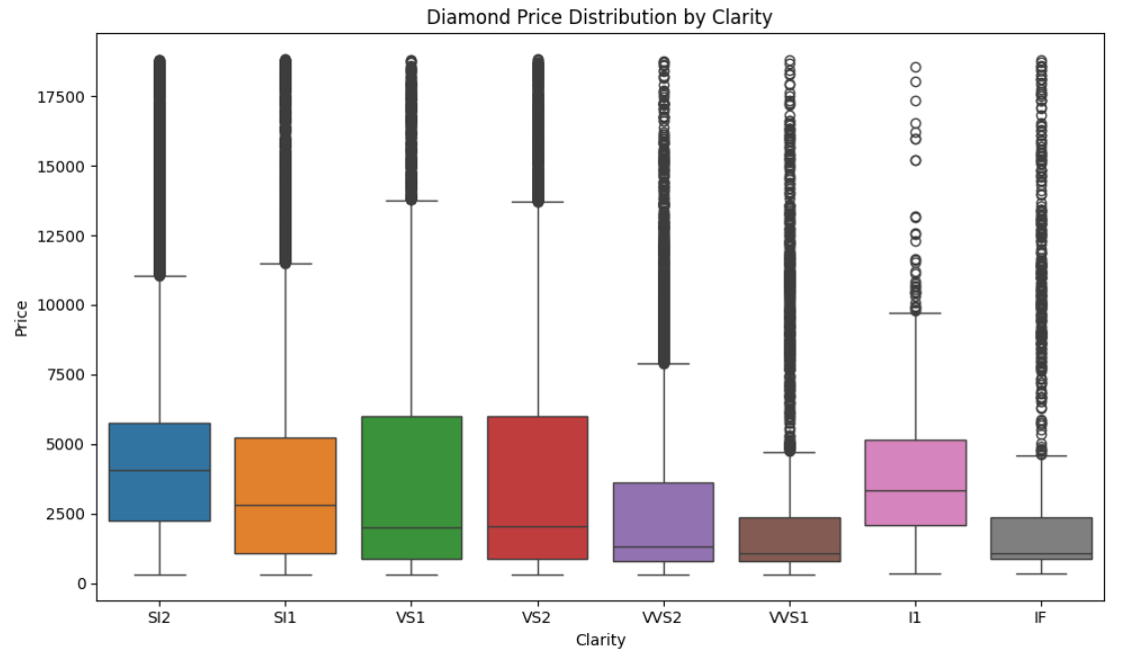
Box plot of price by clarity

Slide 11
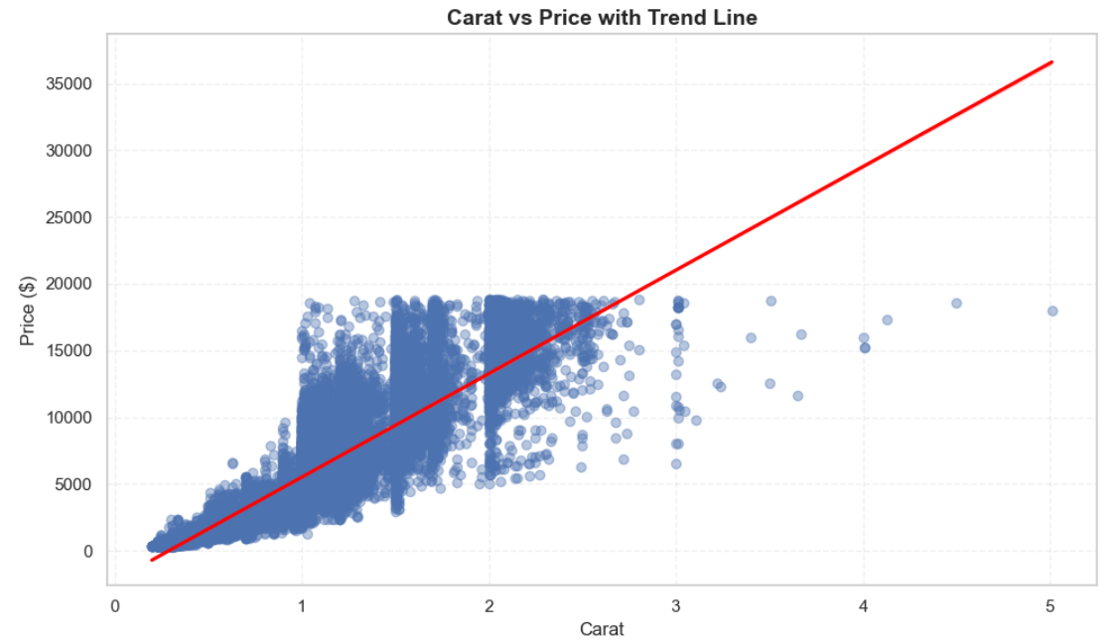
Average price by grouped color/carat
Interpretation
Strong positive correlation: as carat increases, price rises — often nonlinearly.
The regression line shows that price increases faster than carat - especially beyond 1 carat.
Clusters due to popular carat sizes (like 0.5, 1.0)

Slide 12
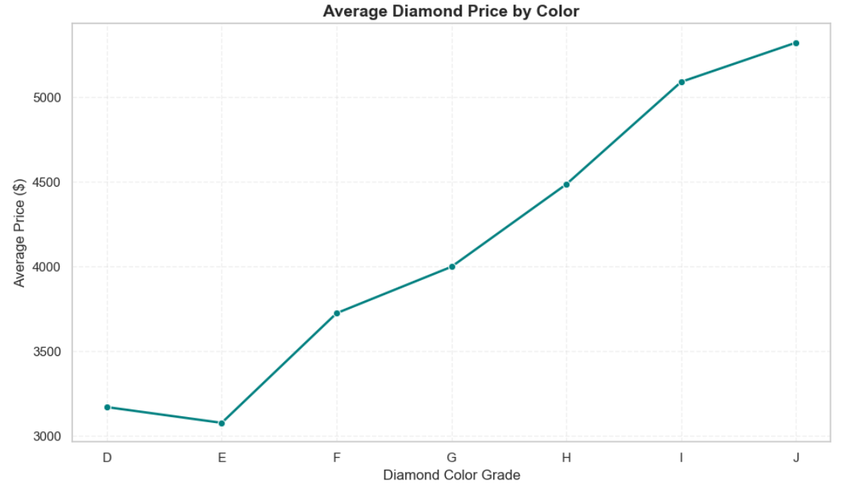
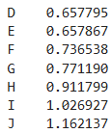
Average price by grouped color/carat
Color Carat

Slide 13
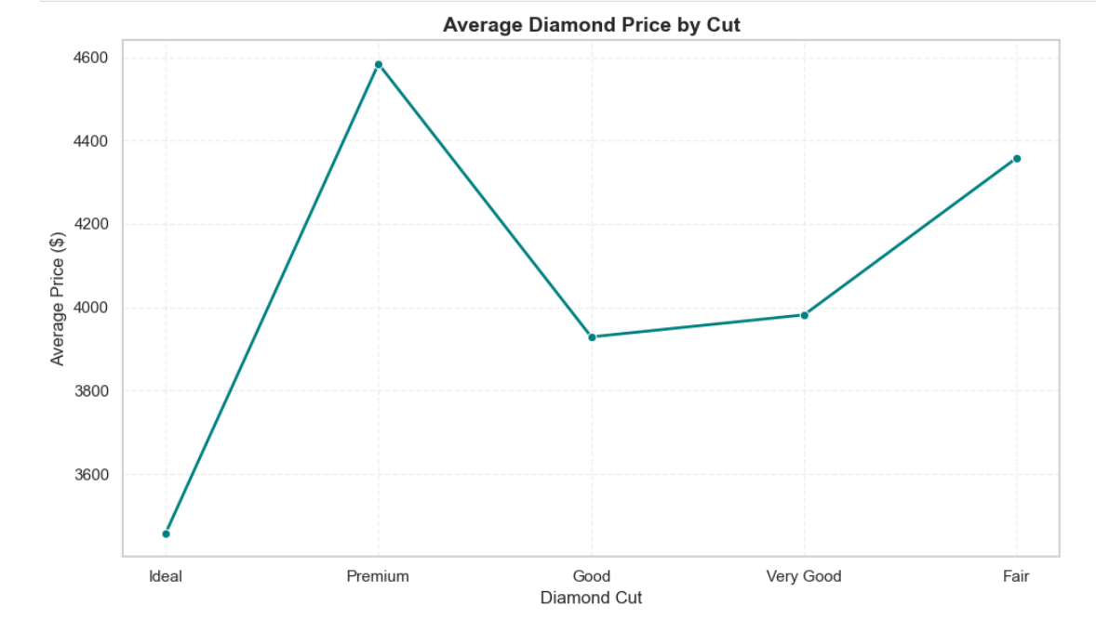
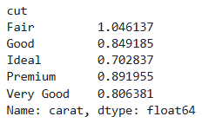
Average diamond price by cut

Slide 14
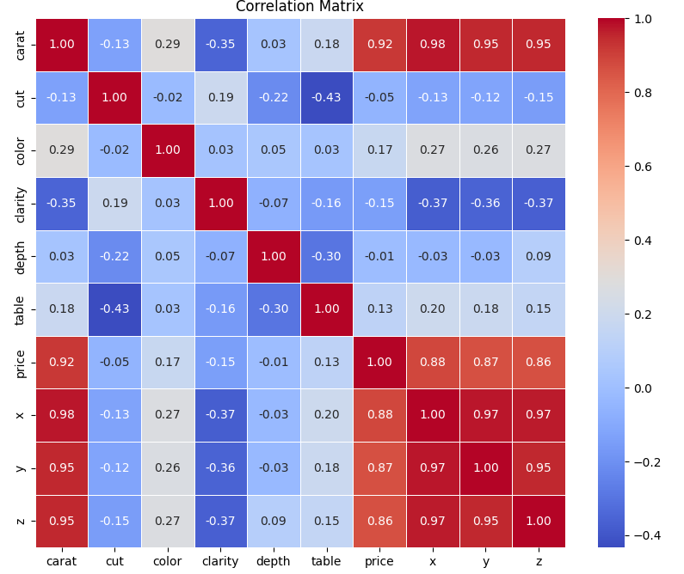
Correlation matrix of dataset

Slide 15
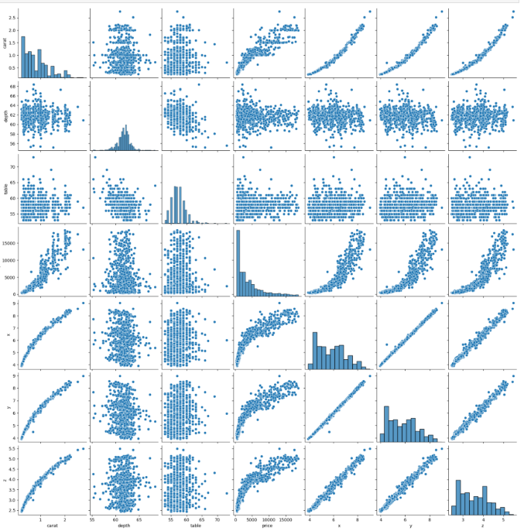
pair plot

Slide 16
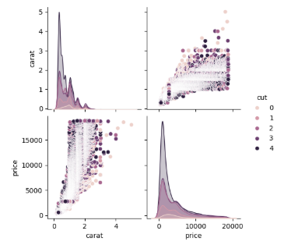
Pairplot of price & carat

Slide 17
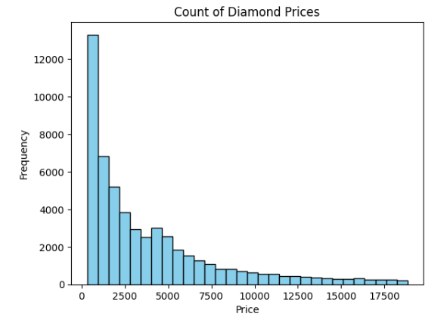
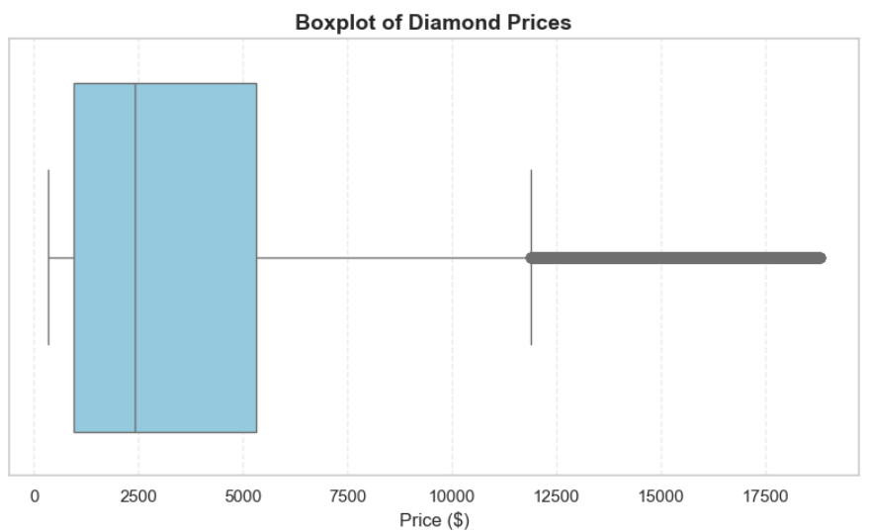
diamond prices
Min Price $326
Max Price $18,823
Most diamonds are in this low price range between $326 to $2,175. Majority of sales volume are likely here.

Slide 18
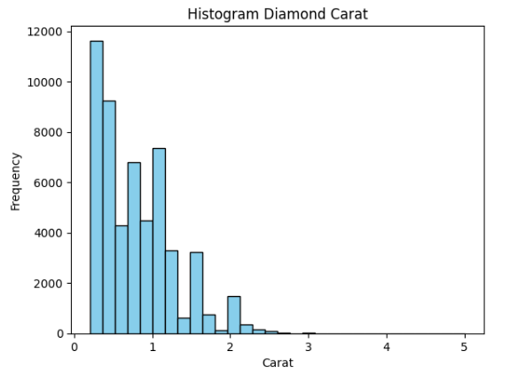
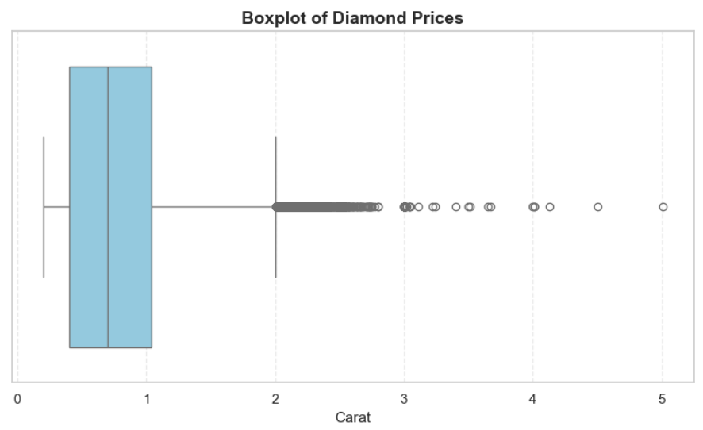
diamond carat
Min Carat 0.2
Max Carat 5.01
Majority Carat 0.1 to 0.3

Slide 19
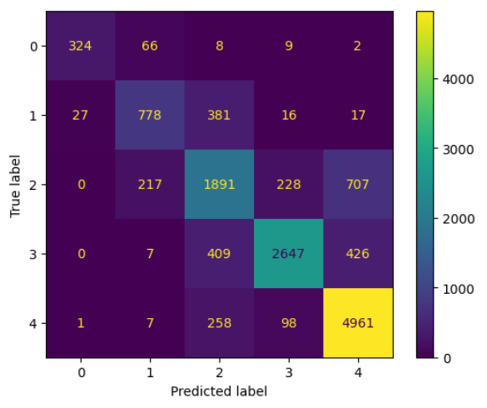
Classification Model ( 'Cut’ as label)
ANN Confusion Matrix
Model | Accuracy | Precision | Recall | F1 Score
Linear Regression | 0.65 | 0.65 | 0.65 | 0.65
KNN Classifier | 0.67 | 0.64 | 0.67 | 0.64
SVC | 0.76 | 0.76 | 0.76 | 0.76
Decision Tree | 0.76 | 0.77 | 0.75 | 0.76
Random Forest | 0.76 | 0.75 | 0.76 | 0.76
ANN | 0.79 | 0.79 | 0.79 | 0.78

Slide 20
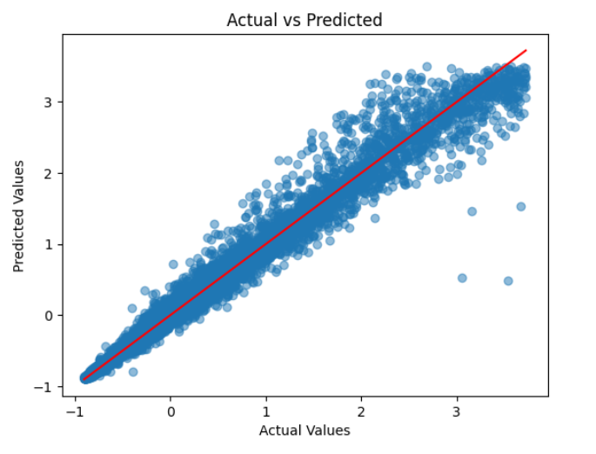
Regression Model (‘Price’ as label)
RF
Model | R2 | MSE | MAE | RMSE
Linear Regression | 0.91 | 0.09 | 0.2 | 0.3
KNN Regressor | 0.97 | 0.03 | 0.09 | 0.18
SVR - rbf kernel | 0.98 | 0.02 | 0.08 | 0.14
SVR -linear kernel | 0.86 | 0.13 | 0.27 | 0.37
Decision Tree Regressor | 0.97 | 0.03 | 0.09 | 0.19
Random Forest Reg | 0.98 | 0.02 | 0.07 | 0.14
ANN Regressor | 0.98 | 0.08 | 0.02 | 0.15

Slide 21
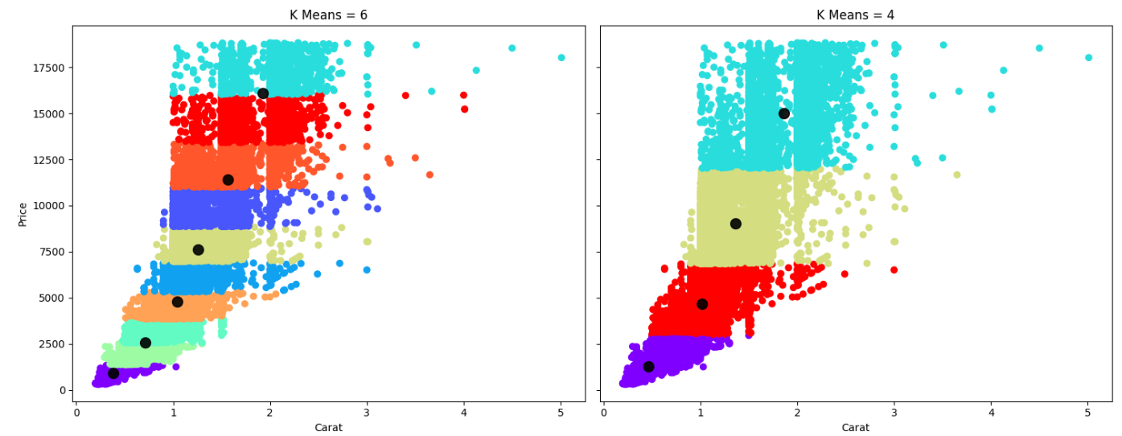
K-means clustering - CARAT VS PRICE
4 Clusters

Slide 22
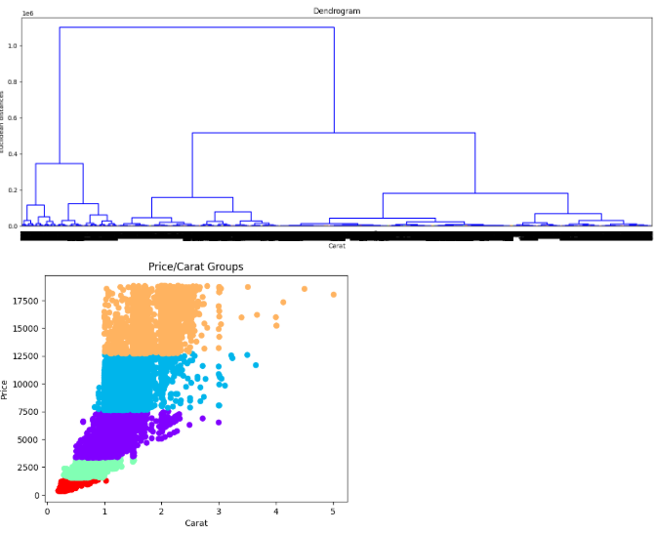
HIERARCHICAL CLUSTERING - CARAT VS PRICE
5 Clusters

Slide 23
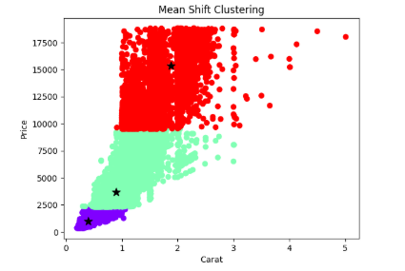
MEAN-SHIFT CLUSTERING – CARAT VS PRICE
3 Clusters

Slide 24
SUmmary
Classification
Best performance: Artificial Neural Network (ANN)
Highest accuracy (0.79) and balanced scores across precision, recall, and F1.
Linear Regression (used for classification) performed the weakest, with all metrics at 0.65, indicating it may not be ideal for this classification task.
Regression
Random Forest Regression is the best overall with R2 of 98%,, lowest MAE (0.07) and RMSE (0.14) — excellent prediction accuracy and stability.
Clustering
All three models revealed different cluster counts, indicating underlying variation in how the data is grouped (k-Means 4clusters, Hierarchical 5 clusters, MeanShift – 3 clusters).

Slide 25
LESSON LEARNT/CHALLENGES
Better Understanding / Application of ML Models
Knowledge Gap of Jewelry Market
Clustering Model

Slide 26
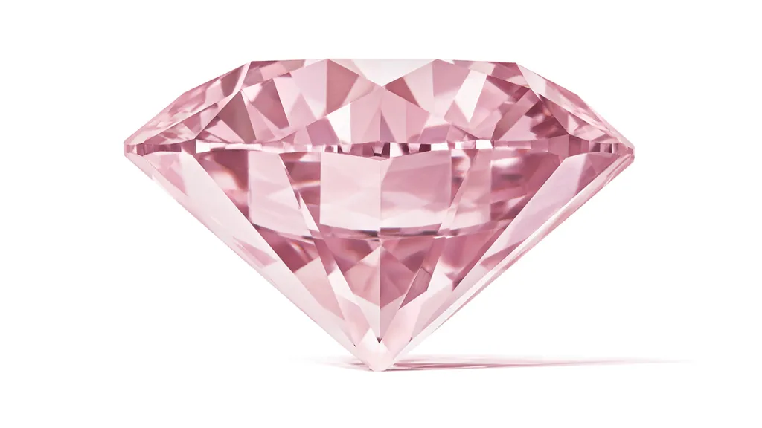
Thank You
Linda.Ukpele@ahoo.com

